Slide 1
DIMACS BioMath Connection Introduction
Field Tester Workshop
July 9, 2009
Holly Gaff

Slide 2
Overview
Ecology 101
What is Ecology?
Why Study Ecology?
How to Study Ecology?
Where does Ecology fit?
Ecology and Math
Meet the Modules

Slide 3
What is Ecology?
Origin of word from Greek:
oikos = household
logos = study of
Interesting parallels to “Economics”

Slide 4
What is Ecology?
Merriam-Webster:
a branch of science concerned with the interrelationship of organisms and their environments
the totality or pattern of relations between organisms and their environment

Slide 5
What is Ecology?
Odum (1963) “The structure and function of Nature”
Krebs (1972) “Ecology is the scientific study of the processes regulating the distribution and abundance of organisms and the interactions among them, and the study of how these organisms in turn mediate the transport and transformation of energy and matter in the biosphere”

Slide 6
What is Ecology?
Ecology is science, biological-based and value-free
Ecology is about the environment but is NOT environmentalism
Ecology can be deep, but it is NOT “deep ecology”
Ecology includes humans but it is NOT “human ecology”

Slide 7
Why Study Ecology?
Curiousity
Why aren’t there penguins in New Jersey
What do earthworms eat?
Why can’t we just get rid of all ticks? They are just icky anyways!

Slide 8
Why Study Ecology?
Responsibility
How do our actions change our environment?
How do we minimize harm to the environment?
How many fishing licenses can we issue without destroying a lake?

Slide 9
Why Study Ecology?
Nature is a guide
Nature has solved lots of hard problems
Where should we live?
What can we learn from how animals live in various ecosystems?

Slide 10
Why Study Ecology?
Sustainibility
How can we live to promote life on earth in the future?
Should we depend on non-renewable resources?

Slide 11
Why Study Ecology?
Ecology helps us understand complex problems
Invasive species
Extinction

Slide 12
How to Study Ecology?
Observations
Go to field
Record what is happening
Look for relationships

Slide 13
How to Study Ecology?
Microcosms
Isolate a portion of an ecosystem
Limit some factors
Manipulate conditions
Assess impact
Refine understanding of ecosystem

Slide 14
How to Study Ecology?
Mathematical Models
Describe interactions as equations
Test understanding of relationships
Predict future outcomes of changes in ecosystems

Slide 15
Where does Ecology fit?
Atoms
Molecules
Organelles
Cells
Tissues
Organisms
Organs
Populations
Community
Ecosystem
Biome
Biosphere

Slide 16
Where does Ecology fit?
Population – Group of interacting and interbreeding organisms
Community – Different populations living together and interacting
Ecosystem – Organisms and their environment
Biome – large scale areas of similar vegetation and climatic characteristics
Biosphere – Union of all ecosystems

Slide 17
Why Math in Ecology?
Math expresses ecological relationships
Interacting populations are natural fit for math equations
Math models provide laboratory for ecological models
Ecology questions are often too hard or impossible for real experimentation

Slide 18
Modeling
An abstract, simplified construct related to a part of reality and created for a particular purpose
We use conceptual models everyday
May not be quantitative

Slide 19
Math Modeling
An abstract, simplified construct related to a part of reality and created for a particular purpose
No more and no less than a tool to support clear thinking
Codifies conceptual models
Make conceptual ideas more quantitative

Slide 20
Math Modeling
Useful tools for description of observed data
Used to explore assumptions concerning dynamic processes
Useful for hypothesis testing
Prediction of future events
Teaching subtleties of ecological processes

Slide 21
Math Ecology Research
Ecology of tick-borne diseases
South Florida restoration

Slide 22
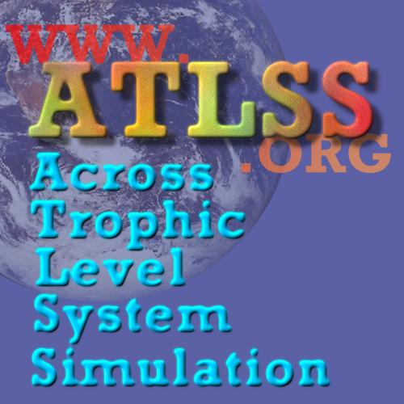

Slide 23
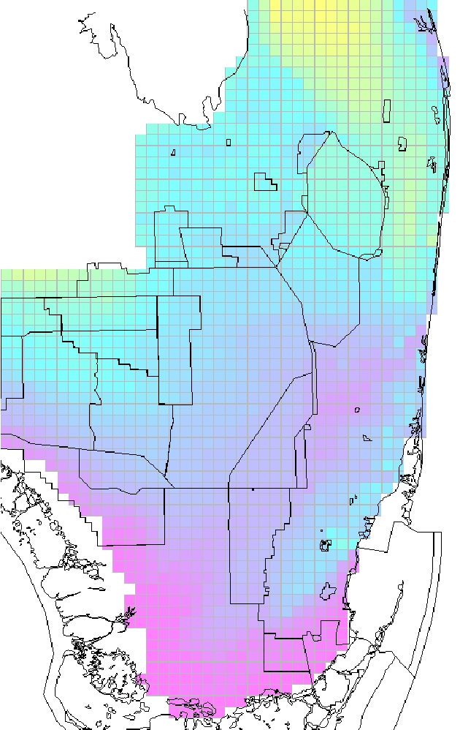
Fish populations are an important source of food for wading birds in South Florida

Slide 24
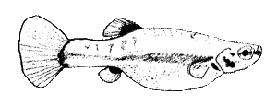
Example of Small Fish
Least Killifish
Heterandria formosa
Female
Male

Slide 25
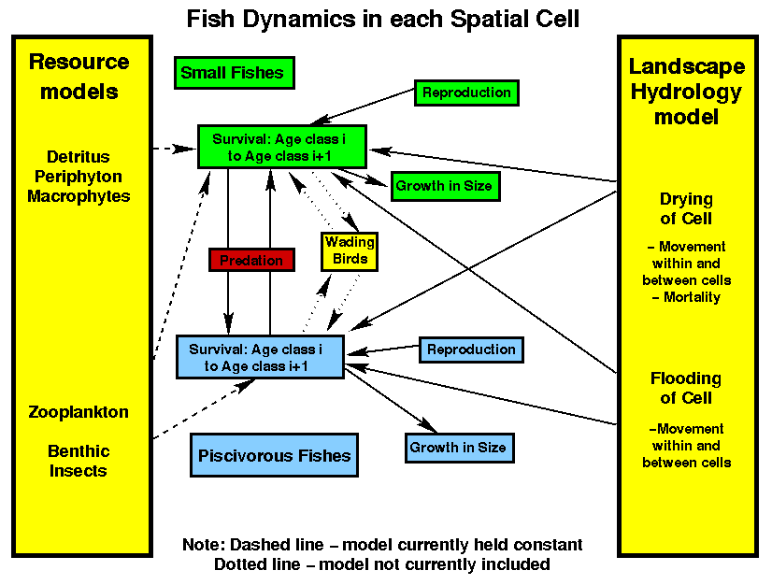

Slide 27
Hands On
Measurement relationships
M&M game for conversion factors
Predator-Prey game

Slide 28
Can you guess my shoe size?
What would you need to know to guess someone’s shoe size?
How would you use data to test various relationships?

Slide 29
Guess my shoe size
Get into groups of about 5 folks
Collect data on everyone’s height and shoe size
Plot the data and use that to predict my shoe size

Slide 30
Guess my shoe size
U.S. Men's Shoe Size | Inches
6 | 9.31
6.5 | 9.5
7 | 9.69
7.5 | 9.81
8 | 10
8.5 | 10.19
9 | 10.31
9.5 | 10.5
10 | 10.69
10.5 | 10.81
11 | 11
11.5 | 11.19
12 | 11.31
12.5 | 11.5
13 | 11.69
13.5 | 11.81
14 | 12
14.5 | 12.19
15 | 12.31
U.S. Women's Shoe Size | Inches
5 | 8.6875
5.5 | 8.8125
6 | 9.00
6.5 | 9.19
7 | 9.31
7.5 | 9.50
8 | 9.69
8.5 | 9.81
9 | 10.00
9.5 | 10.19
10 | 10.31
10.5 | 10.50
11 | 10.69
11.5 | 10.81
12 | 11.00

Slide 31
Guess my shoe size
I am 5’11”
So what is my shoe size?

Slide 32
Conversions
How do you compare two items in a store?
What goes into the price of an item?
Does it usually cover the entire cost of the item?

Slide 33
Apples vs. Oranges
Cost | M&M color | Granny Smith apple | Navel Orange
Land | red | 1 | 1
Fertilizer | blue | 2 | 1
Labor | green | 2 | 3
Transportation | Brown | 1 | 4
How many apples can you make? How many oranges? How many different combinations can you make? What price would you charge for each?

Slide 34
Interaction Populations
Start with 9 rabbits spread across the meadow
Toss the lynx square once to catch rabbits
Lynx survives if land on (consumes) at least one rabbit
If lynx consumes 3 rabbits, lynx survives and reproduces
All rabbits breed so double the number of rabbits and disperse across the meadow
If no lynx, one immigrates. If no rabbits, 3 immigrate
Repeat

Slide 35
Footprint

Slide 36
Biological Concepts
Carrying capacity
Ecosystem
Source-sink
Carbon footprint
Sustainability

Slide 37
Mathematical Concepts
Conversion factors
Log-scale plots
Graph analysis
Estimation
Modeling

Slide 38
Log-scale Plots

Slide 39
Food Webs

Slide 40
Biological Concepts
Food chains/webs
Trophic level
Energy flow
Producers, consumers
Predator vs. prey
Keystone species

Slide 41
Mathematical Concepts
Digraph
Path length
Arcs/arrows
Points/Vertex
Order of magnitude
Rates and flows
Modeling

Slide 42
Math Concepts
Digraph = directed graph
Vertex
Vertex
Vertex
Arc Length

Slide 43
Habitat Selection

Slide 44
Biology Concepts
Abiotic vs. biotic factors
Community
Habitat
Niche
Species
Population

Slide 45
Math Concepts
Dependent vs. independent variable
Modeling
Fitting lines, regression
Graphing data
Slope-intercept
Trendlines

Slide 46
Fitting a line

