Slide 1
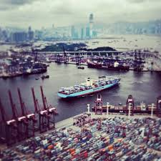
Risk Assessment for Integrated Cyber and Physical Attacks on Critical Infrastructure
Fred S. Roberts
CCICADA Center, Rutgers University
Source for all images: wikimedia commons
1

Slide 2
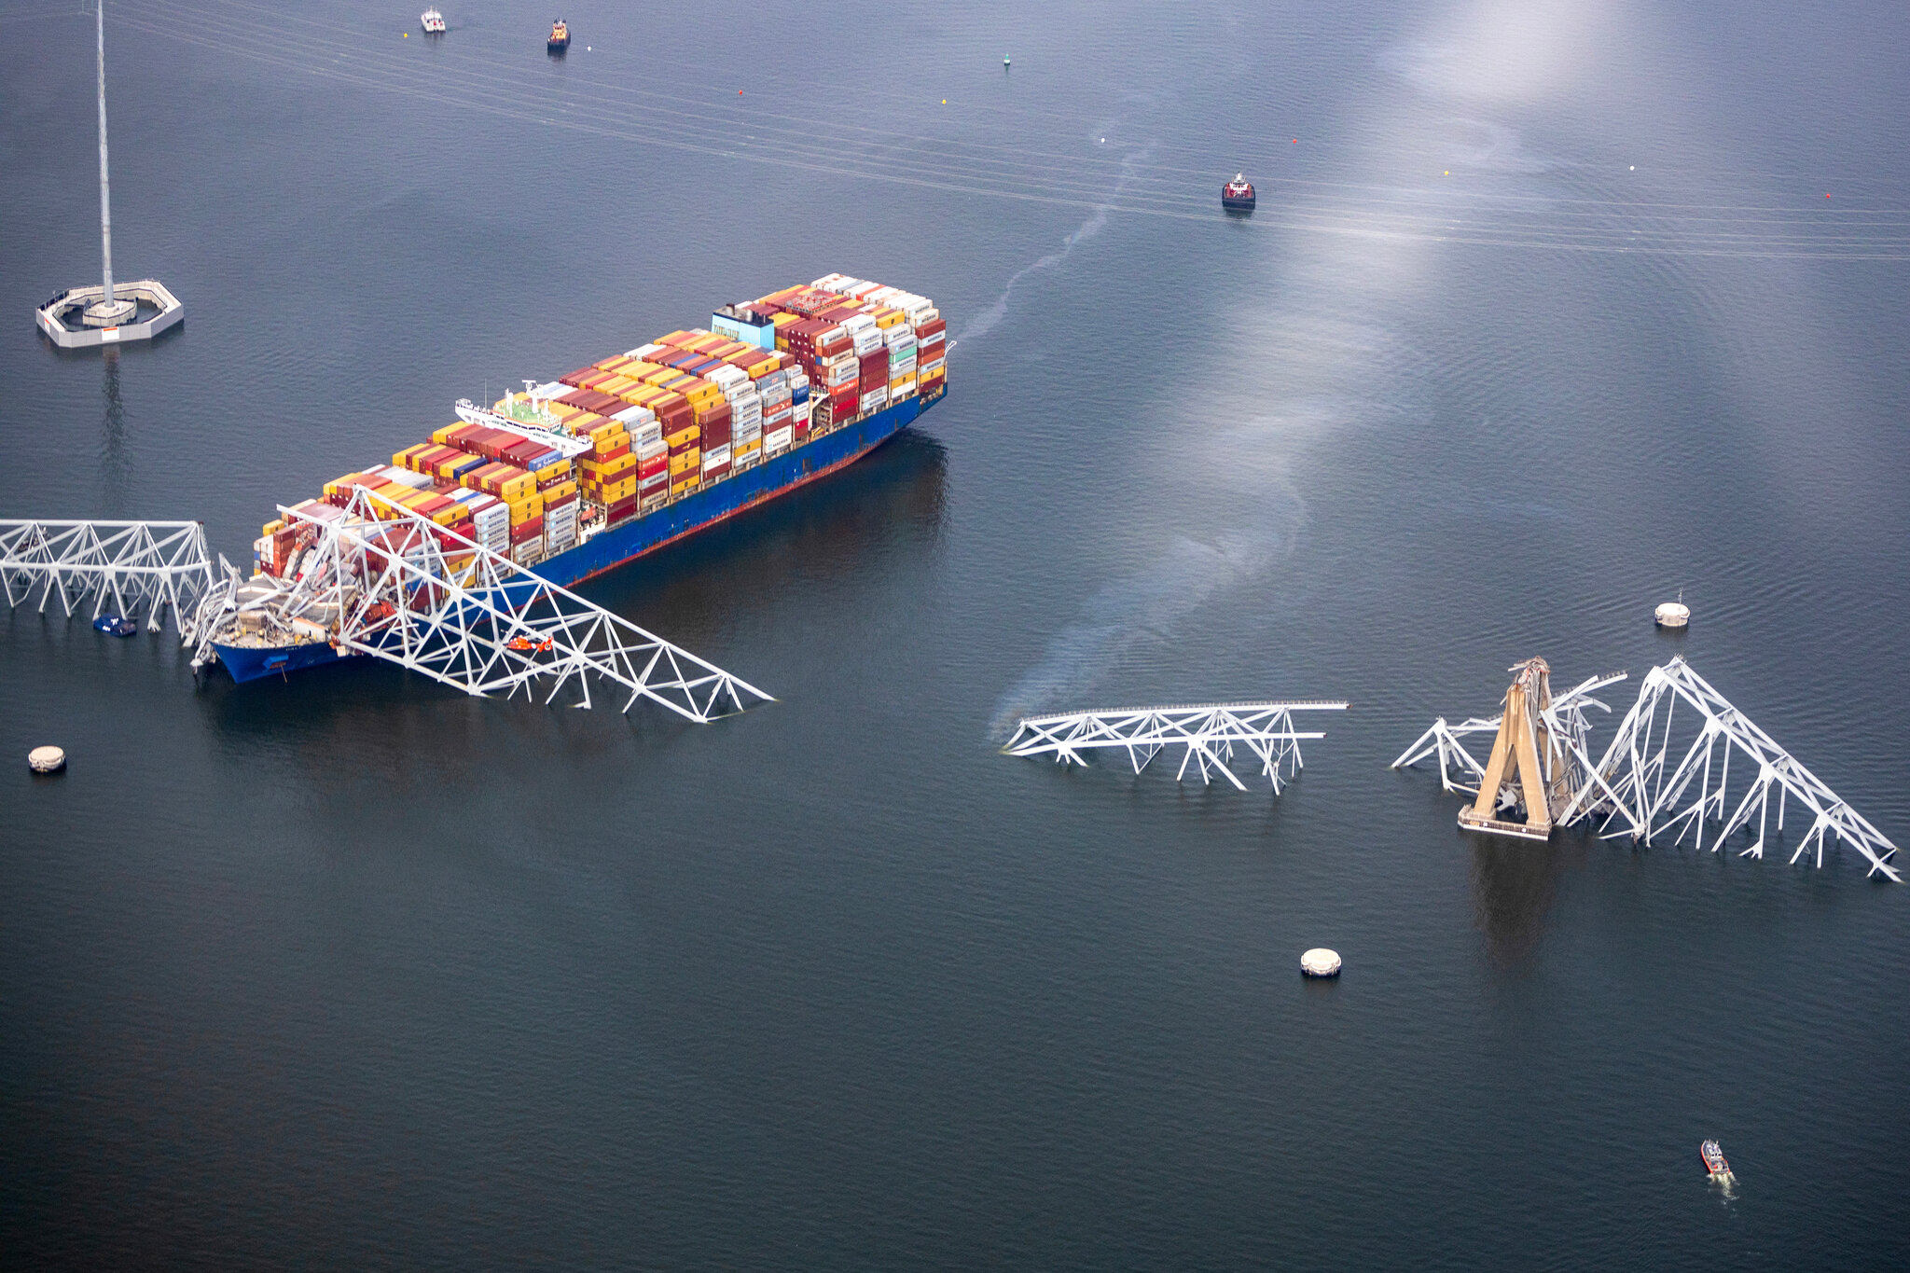
Baltimore, March 26, 2024
Container ship crashes into Baltimore’s Francis Scott Key Bridge
Bridge collapses
Moments before crash, the vessel lost power
Was it due to a cyber attack?

Slide 3
Integrated Cyber and Physical Attacks
A great deal of discussion about physical security in the maritime transportation system (MTS).
Leads to standards, regulations, etc.
Increasing interest in cyber security in the MTS.
Leading to discussion of best practices.
But more sophisticated attacks will be multi-modal.
Could lead to more harm.
Simple example: hacking into security cameras at a port increases vulnerability to a physical intrusion.
Special case: cyber attack as precursor to physical attack, or vice versa.
Precursor attack is not the end in itself; intended to increase impact of following attack.
3

Slide 4
Integrated Cyber and Physical Attacks
Similar integrated cyber and physical attacks relevant to all kinds of infrastructure.
The cyber could precede the physical or vice versa.
Will give examples from:
MTS
Sports stadiums
Railroads
Power systems
There is a literature on risk assessment for cyber attacks and for physical attacks; virtually nothing on integrated attacks.
Will describe the beginnings of a risk assessment approach.
4

Slide 5
Marine Transportation System
5

Slide 6
A Simple Example: Fake News
Fake news could be spread via social media.
Something is happening at Pier F in the port.
Draws first responders to Pier F.
“Everyone runs to the soccer ball”
Actual intent is to attack Pier L, which now may have less protection.
Another version: hack into a company’s or agency’s email system and generate an official-looking report about Pier F.
John Smith
@johnsmith
There is a shooter at Pier F
2:23 PM 6 Dec 2017
Tina Jones
@tinajones
People shot at Pier F
2:22 PM 6 Dec 2017
6

Slide 7
A Simple Example: Fake News
Another version: Spread news that a celebrity is at Pier F; draw a crowd; then attack the crowd.
“Justin Bieber is at Pier F”
Source: wikimedia commons
7

Slide 8
More Sophisticated Attacks on a Port
Cyber attack on operating systems in the port making a following physical attack more likely to succeed:
Shut the gates so people are trapped inside and first responders are trapped outside.
Turn off the lights – make it easier for physical attackers.
Turn off the alarms – make it easier for physical attackers to avoid detection.
Disable the cameras – make it easier to avoid detection.
Interrupt the power supply.
Disable cyber-enabled traffic lights to create traffic jams - emergency vehicles unable to respond to a physical attack.
Hack into emergency communication system and tell first responders to go to a different place.
Spoof TWIC cards or other access control systems
to let the “bad guys’ in.
8

Slide 9
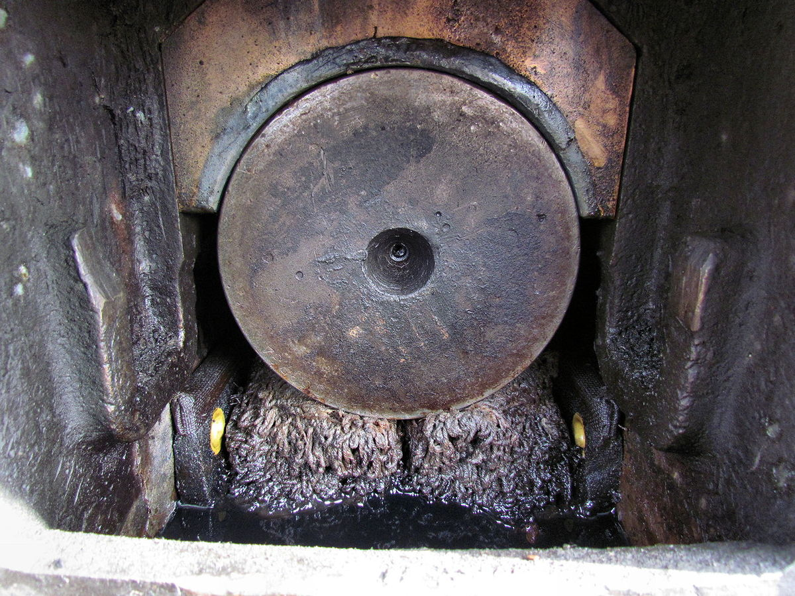
Monitoring Vessels from Elsewhere
There is increasing interest in being able to monitor the behavior of shipboard systems from elsewhere, e.g., company HQ.
Now, engine manufacturers can monitor their engines for reliability, but also to make sure they are not being abused - which would void a warranty.
They might be watching sensors that give advance notice that something isn’t working right.
E.g., you might detect vibrations before a bearing goes bad.
Bottom line: many outsiders have access to vessel systems.
A bad actor could hack into your system from outside, especially if your shipboard systems are
networked.
Credit: En.wikipedia.org
Corroded bearing
9

Slide 10
Monitoring Vessels from Elsewhere
Monitoring from elsewhere also leads to a different integrated attack scenario: Start with a physical attack on the remote monitoring facility that allows the adversary to take over the facility and send malicious code to your vessel.
What about autonomous vessels: Could you hack
into HQ computer and direct vessel to go to
place it could be boarded by attackers?
Could a hacker attack a vessel control system through a HQ computer and disable a sensor designed to identify increasing temperature, pressure, or hazardous gas? Leading to an explosion.
10

Slide 11
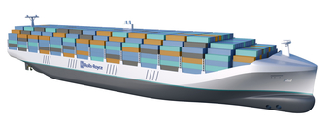
Autonomous Vessels
Autonomous vessels are coming, soon.
Such vessels:
Will be programmed to decide where to go.
Will be tracked and monitored using diagnostics from HQ.
Will put out a problem message if unable to solve a problem, resulting in HQ sending instructions on where to go for repair.
Do we trust the technological solutions so such vessels can go alone on the seas?
Could a hacker take over the HQ computer and instruct the vessel to go to a place where it could be boarded by attackers?
Rolls Royce Autonomous Ship Concept
Credit: Rolls Royce, iecetech.org

Slide 12
Debarking a Cruise Ship
In general, disembarking at cruise ship terminals is generally not thought to be very risky.
Passengers are released in groups to avoid standing in line at customs.
There is good departing security.
Terminal operators think you are ok once you leave the dock.
But what if a hacker could manipulate an alarm system to get them all to debark at the same time and attack them outside the gates?
There is still an under-appreciation of debarking
vulnerabilities.
Credit: royalcaribbean.com/
12

Slide 13
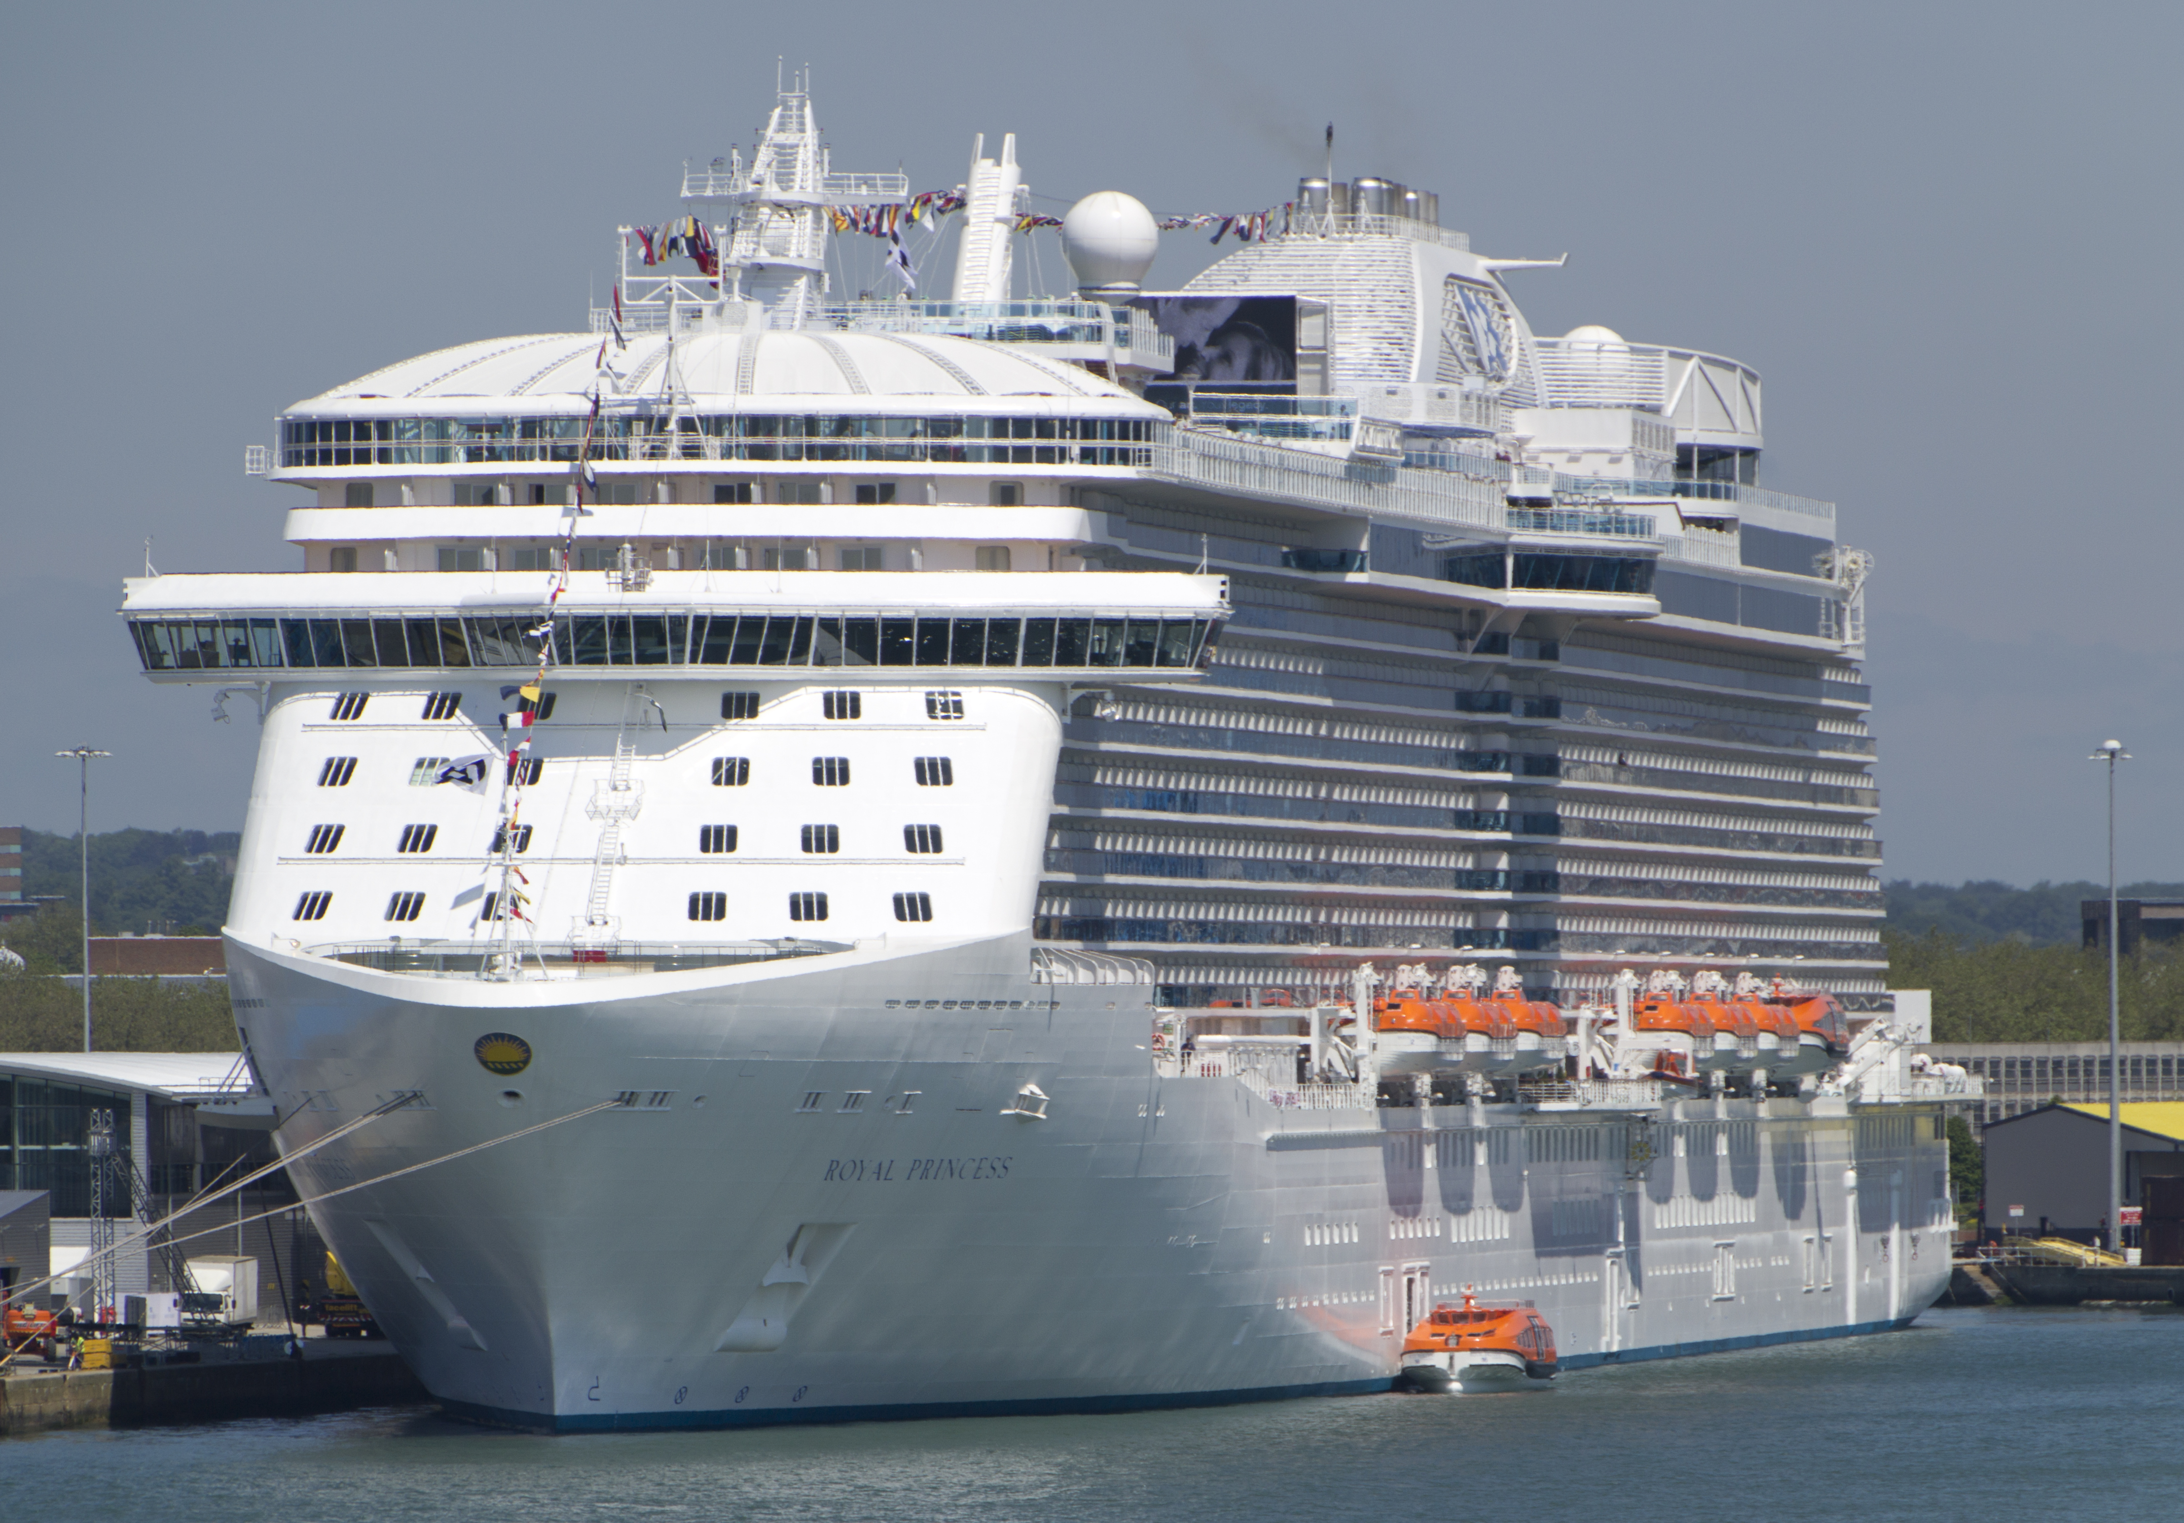
Debarking a Cruise Ship
Could a hacker manipulate a port alarm system (e.g., fire alarm) to get passengers to debark at the same time?
That might depend upon whether the alarm system were online.
Port fire alarm systems are not too sophisticated.
They are designed to operate over a network and push a signal out to a monitoring agency.
It might be a challenging hack to get into this system.
Physically setting off the fire alarm might be more likely to succeed.
Credit: commons.wikimedia.org
13

Slide 14
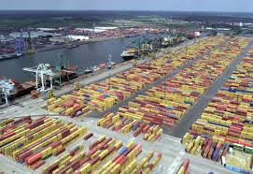
Pirates and Cargo
Hacking into a cargo handling system is feasible.
Port of Antwerp is one of the world’s biggest.
2011-2013: Hackers infiltrated computers connected to the Port of Antwerp, located specific containers, made off with their smuggled drugs and deleted the records.
Attackers obtained remote access to the terminal systems; released containers to their own truckers without knowledge of the port or the shipping line.
Access to port systems was used to delete information as to the existence of the container
after the fact.
Source: Reuters 4/23/14, CyberKeel
Credit: wikipedia.org
14

Slide 15
Pirates and Cargo
The hackers began by emailing malware to the port authorities and/or shipping companies.
After the infection was discovered and a firewall installed to prevent further infections, the criminals broke into the facility housing cargo-handling computers and fitted devices allowing wireless access to keystrokes and screen shots of computer screens.
The first part of this was a cyber attack preceding a physical attack (stealing cargo).
The second part was a physical attack (breaking in) preceding a cyber attack, which in turn preceded a physical attack (stealing cargo).
Source: Bell 2013, Mulrenan 2014, Woodland Group
15

Slide 16
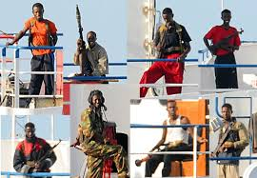
Pirates and Cargo
Pirates have been reported to have hacked into a cargo management system and identified where on a vessel valuable cargo is located.
This enabled them to make a very fast and efficient raid on a vessel, going right to the container of interest.
Is this feasible?
One SME we spoke to felt that it was feasible to hack into the cargo system and identify containers of interest and their location, but wondered how this would help the pirates since it is only the topmost containers they could access.
Credit: wikipedia.org

Slide 17
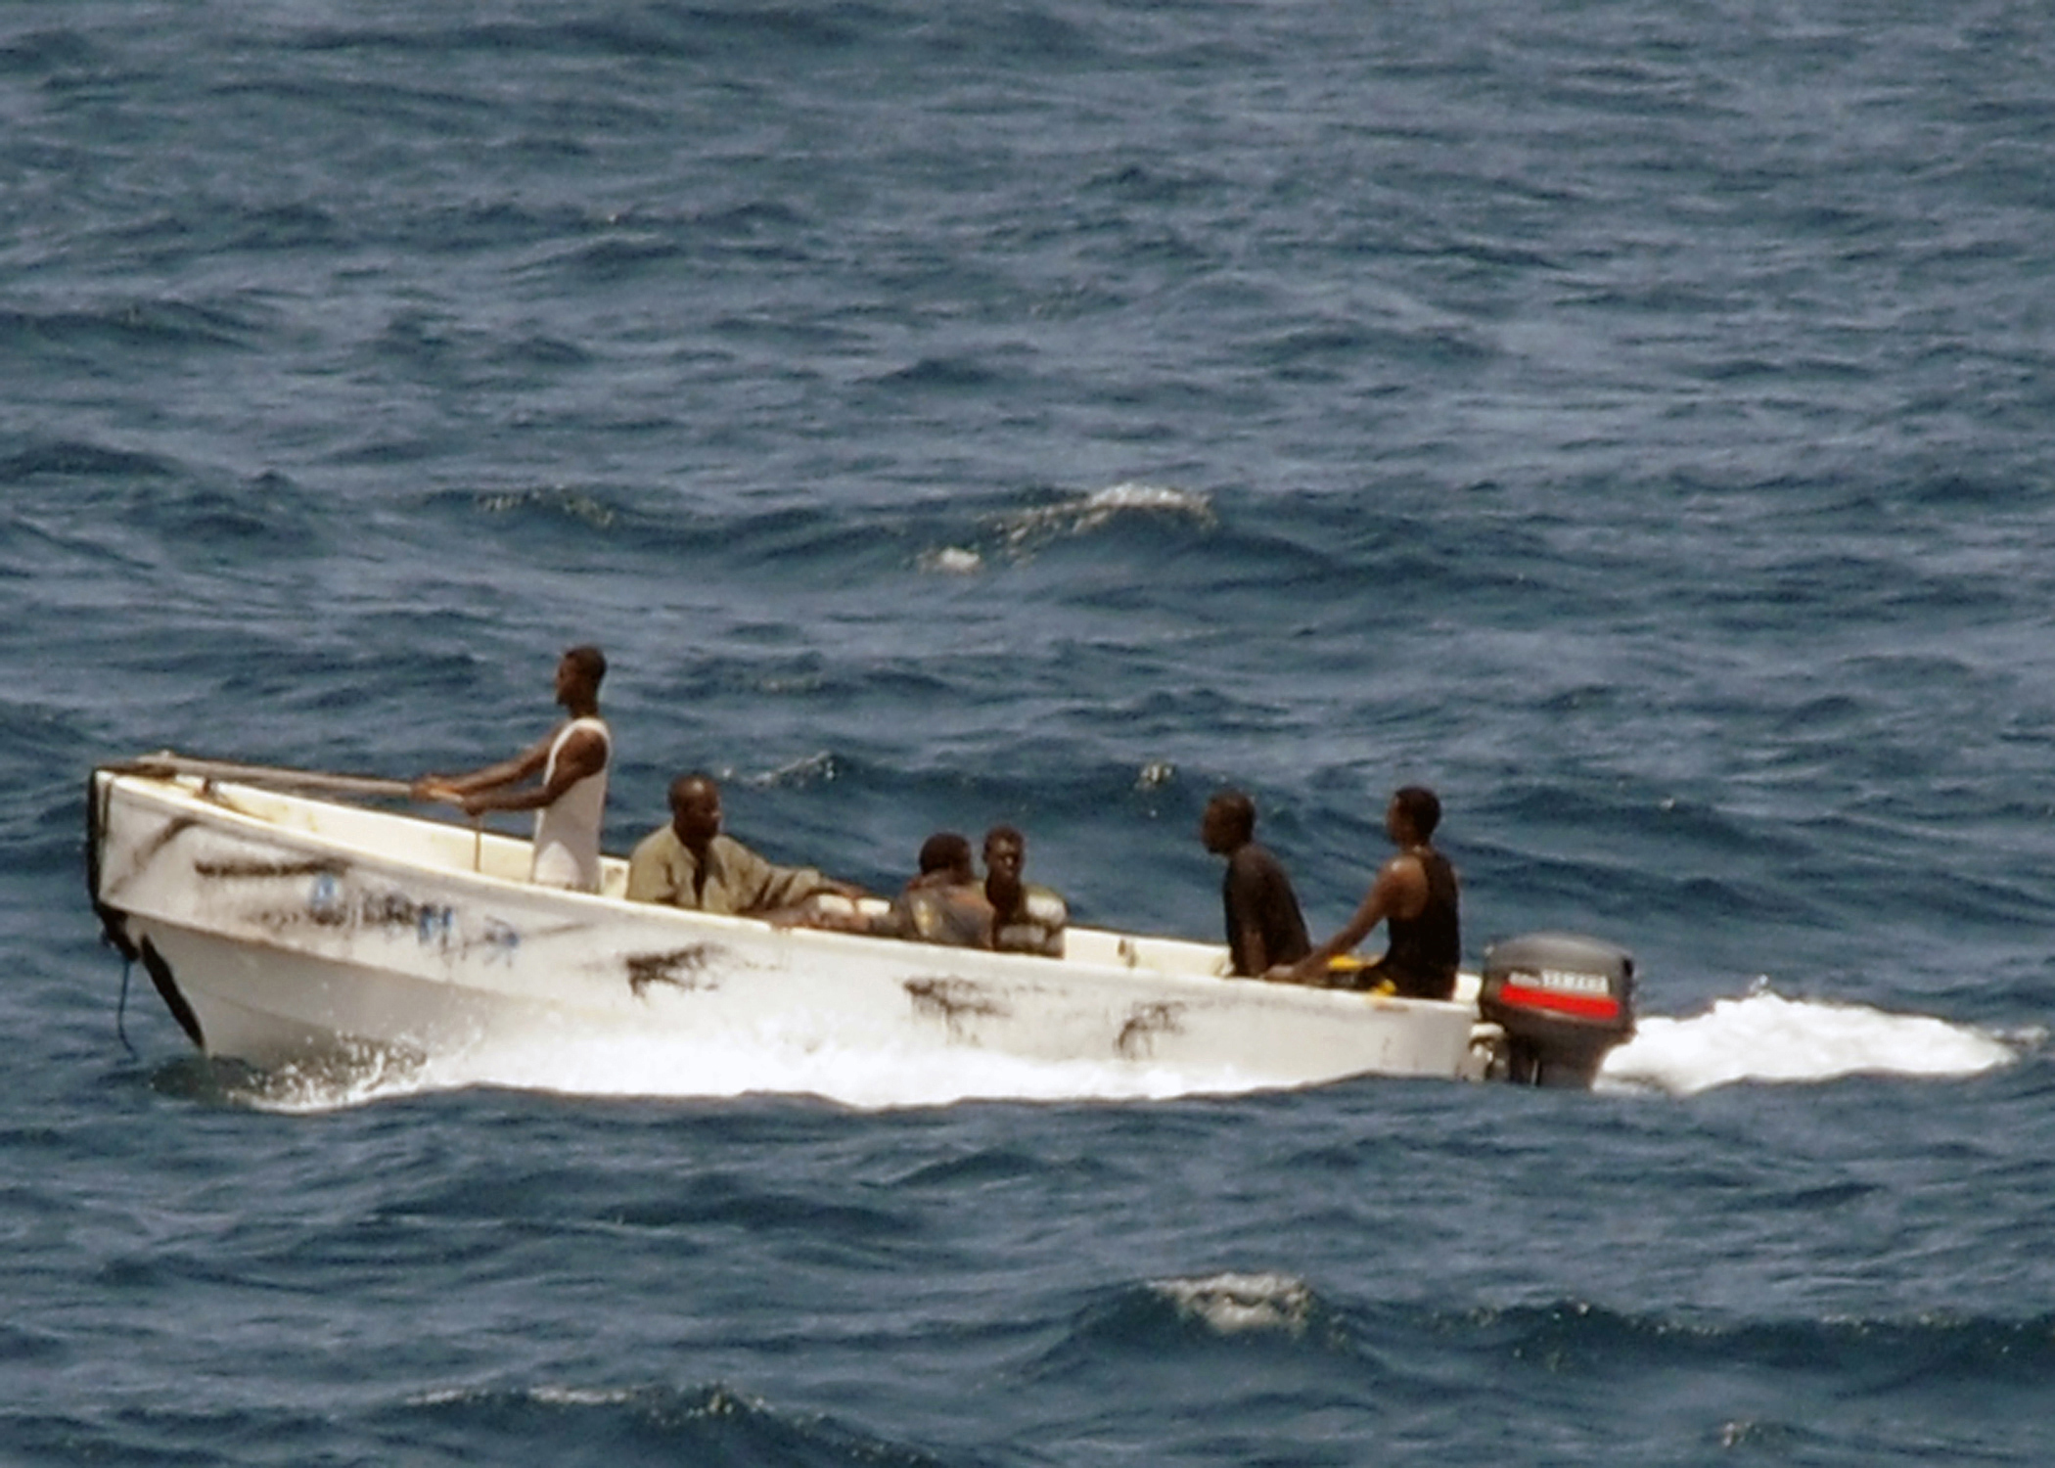
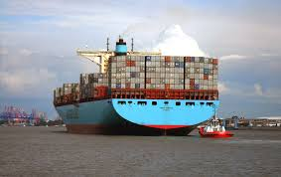
Pirates and Cargo
Another SME pointed out that the USCG had gotten quite good at getting into containers upon boarding a ship.
Still another SME pointed out that the adversary could influence the loading of containers so that those of interest were placed to be accessible.
Credit both images: commons.wikimedia.org

Slide 18
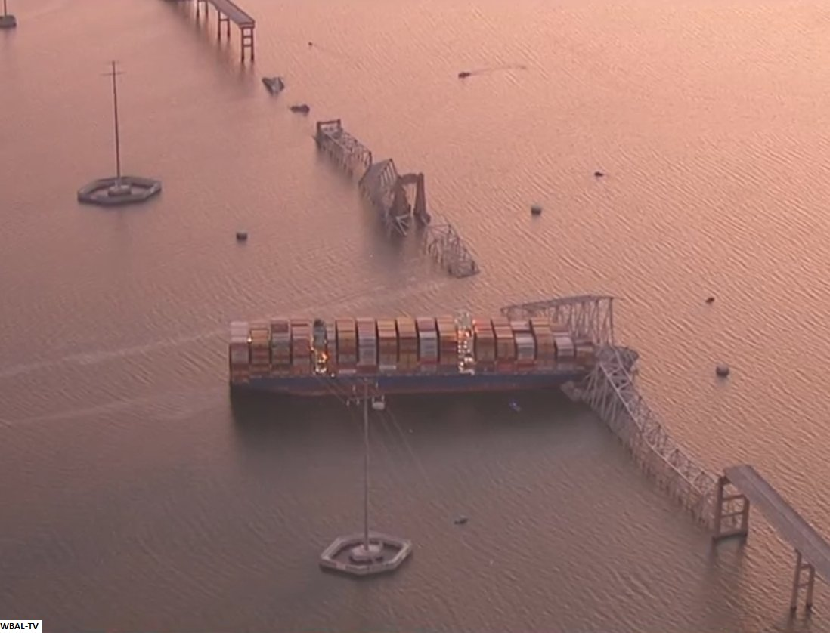
Francis Scott Key Bridge
So even if the container ship crashing into the bridge was not caused by a cyber attack, could it have been?
And could the cyber attack have led to the physical attack/damage that resulted?
A few weeks ago, we might have said “no”
Credit: BNO News

Slide 19
Sports Stadiums
19

Slide 20
Super Bowl 47, New Orleans
Was it terrorism?
Was it cyber-terrorism?
(Luckily just a relay device failing at Entergy New Orleans)
Credit: businessinsider.com
20

Slide 21
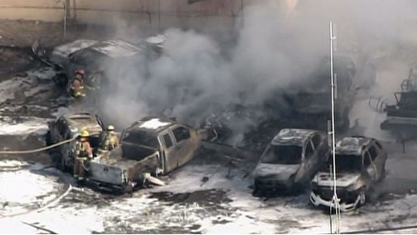
Traffic Control Scenario: Car Hacking at a Stadium
Terror attacks using vehicles on the rise
What if bad actor could control a car remotely and use it in a crowded stadium roadway?
There could be chaos and people hurt
Things would be worse if the chaos caused all traffic to stop, making it ripe for a physical attack on the stranded vehicles and passengers
Credit: ctvnews.ca
21

Slide 22
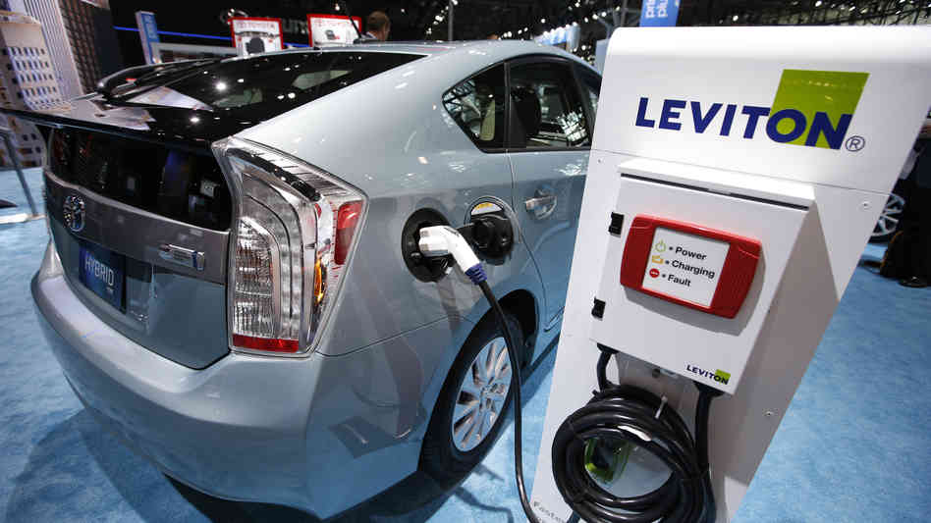
Car Hacking in the Stadium Roadway
2013: Miller (Twitter) and Valasek (IOActive) demonstrated take control of Toyota Prius and Ford Escape from a laptop.
They were able to remotely control:
Smart steering
Braking
Displays
Acceleration
Engines
Horns
Lights
Credit: npr.org
22

Slide 23
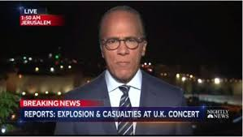
Hacking into the Jumbotron
Attack at Ariana Grande Concert in Manchester, UK – May 2017
People attacked leaving the concert venue.
Could a cyber attack on the message board directing people to leave be a prelude to a similar attack?
23

Slide 24
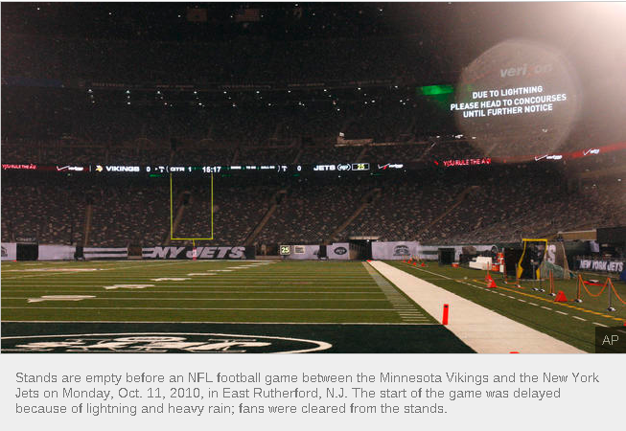
Example: Hacking into the Communications System
This was a real emergency and a real message.
But imagine what chaos a hacker could cause with a fake emergency message.
24

Slide 25
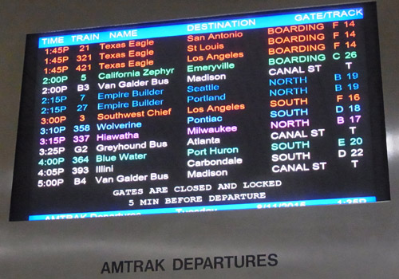
Hacking into the Jumbotron
Hacking into the Jumbotron seems feasible.
In a rail-related incident in 2021, hackers in Iran managed to get into the displays nationwide
They showed rail passengers false information
Credit: Wikimedia commons
25

Slide 26
Rail
26

Slide 27
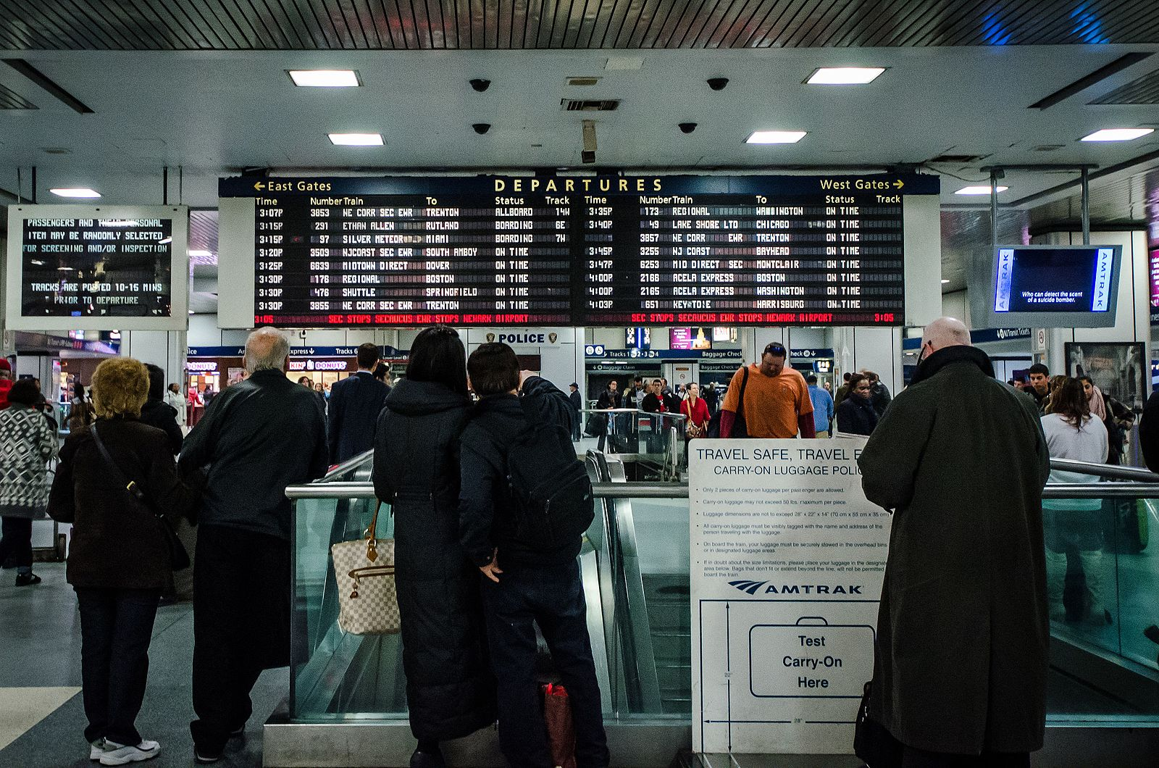
Hacking into the Message Board
In a rail scenario like the Ariana Grande example in Manchester:
Imagine that hackers take control of the display system in a large rail terminal.
And send everyone to the same track with a message that a train is about to leave early.
The stampedes alone could cause major physical damage, but if some bad actors were waiting with weapons or bombs, things could be much worse.
credit: Wikimedia commons, m01229 from USA, no changes
27

Slide 28
Rail Tunnels
Trains go through many tunnels, some very long (as under the Hudson River, heading to New York)
Especially after storms, those tunnels require pumping and draining controlled by cyber-physical systems
What if a bad actor used a cyber-attack to disable a pumping and draining system, but also ensured that status boards indicated that the tunnel was safe?
This could lead to a train getting stuck or key systems being flooded, having the lights and AC go out, and leading to serious injury to passengers; and also setting up a stalled train to physical attack
Credit: Amtrak
28

Slide 29
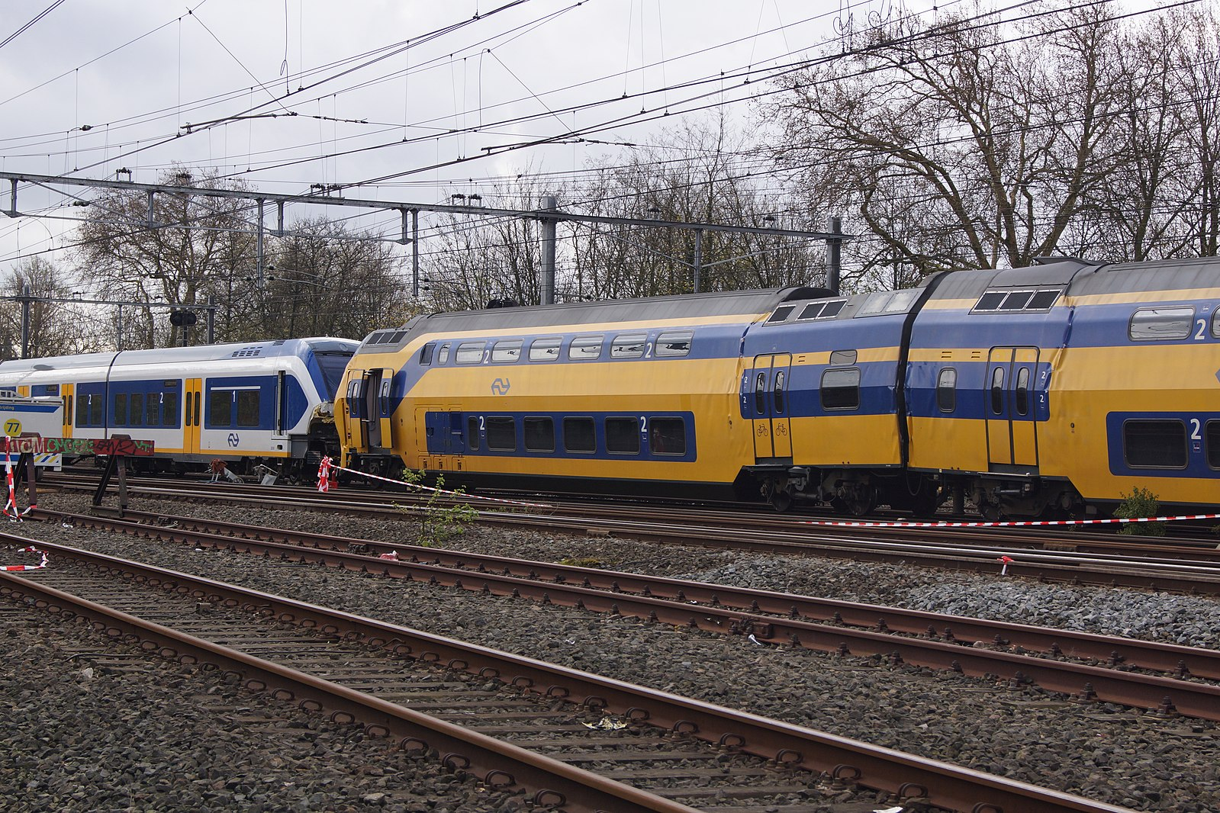
Vulnerability of Rail Signaling and Switching Systems
Could a bad actor take control of a signaling or switching system for a railroad and direct two trains to go on the same track toward each other, leading to a head-on collision as occurred recently in Greece?
In 2022, hackers in Belarus took control of routing and switching devices to stop trains; they also threatened to take down signaling and emergency control systems
This problem could be further exacerbated if the trains were carrying hazardous materials
Image: Two trains collided at Westerpark, Amsterdam on April 21, 2012
Credit: Wikimedia commons Floris Looijesteijn no changes
29

Slide 30
Power Systems
30

Slide 31
Deliberate Blackouts Lead to Power System Explosions
In 2015 Russian hackers were able to gain access to the control systems of three power distribution companies in Ukraine
Caused a blackout that left over 230,000 people without power for several hours
Then used the chaos to carry out physical attacks on the power grid infrastructure
These included cutting power lines and using explosives to damage power stations
Credit: Flickr/ Bundesheer Fotos
31

Slide 32
Deliberate Blackouts Lead to Power System Explosions
The December 2022 physical attack on the power grid in North Carolina left thousands without power for many days.
Had that attack occurred in conjunction with a cyber attack, the outage would have likely been longer and more widespread.
Some smaller power stations, known as “peakers,” are primarily used only when demand is very high and the grid is already stressed.
Hackers could monitor routine communications among power generators to determine when extra power was needed and then conduct a physical, cyber, or integrated attack when the system was most vulnerable.
FBI poster
Credit: Wikimedia commons
32

Slide 33
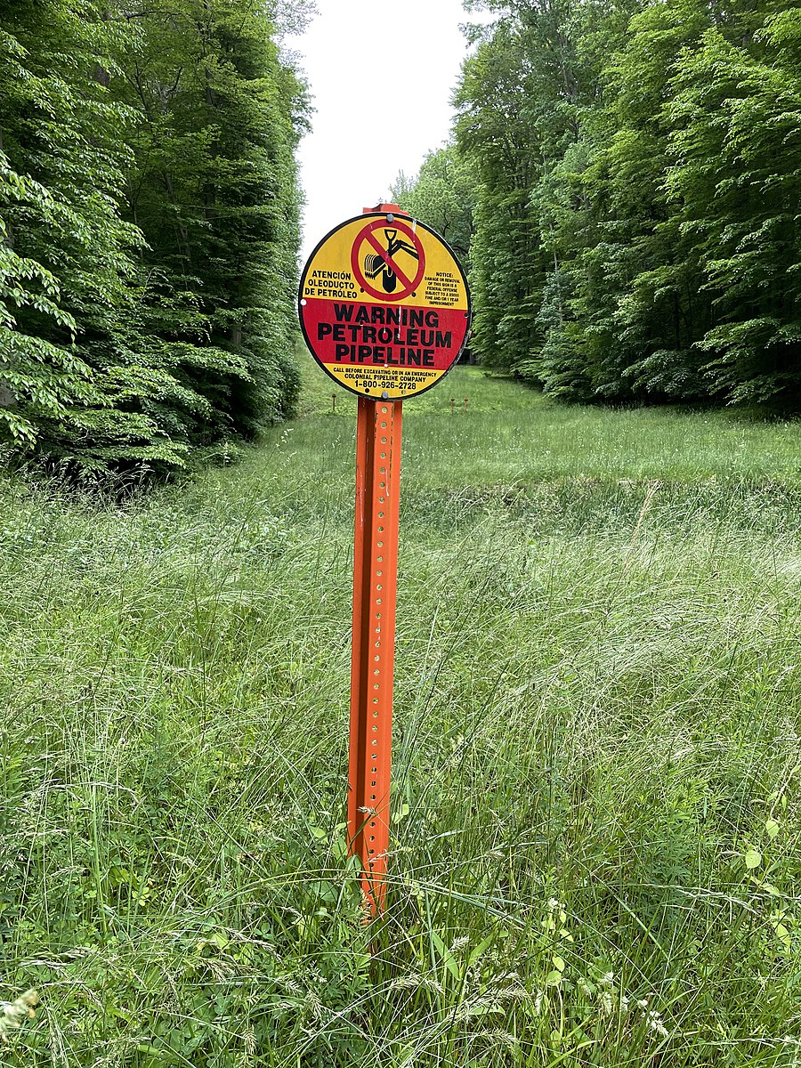
Pipeline Attacks
A 2021 ransomware attack on the Colonial Pipeline led to fuel shortages across five states and panic buying of fuel in many areas.
In fact, pipeline worked fine; but billing system didn’t.
Had the ransomware been accompanied by an even small physical attack it would have required extra physical security and response measures across many miles of pumping stations and pipelines and a longer restoration time.
If an attacker had gained access to the control systems, they might have used the cyber access they gained to plan carefully targeted physical attacks on the pipeline.
credit: Wikimedia commons, Elliott R. Plack
33

Slide 34
Risk assessment
34

Slide 35
Risk Assessment
Many of these integrated attacks seem feasible.
But an adversary with this level of sophistication might find it is easier to do a more intrusive physical attack.
We would like to consider threat, vulnerability, and consequence in determining the risk of a given attack scenario.
But:
Not many examples (as yet) of cyber attacks on certain kinds of infrastructure, in particular the MTS, making threat hard to estimate
Estimates of probability attack will succeed (vulnerability) are essentially speculation
Consequences could be large, making it important to be able to estimate probabilities accurately, which is difficult.
We will approach the problem qualitatively.
35

Slide 36
Risk Assessment
I = integrated attack, started with cyber attack A, followed by physical attack B.
X = non-integrated attack aiming at same impact as B.
Compare probability of success P_{I} and P_{X}, where
P_{I} = P_{A} x P_{B/A} (prob. of success of A times prob. success of B given A) ---- ways to measure vulnerability
Compare costs K_{I} and K_{X} of attacks. ---- replacement for threat; lower cost = higher threat
Compare consequences C_{I} and C_{X} of attacks.
Risk assessment for combined attacks – not well developed.
FEMA provides guidance about complex, coordinated attacks – but these are synchronized and at different locations and risk assessment is very generic.
Event tree analysis deals with risk of one natural
event triggering another (earthquake triggers
landslide).
36

Slide 37
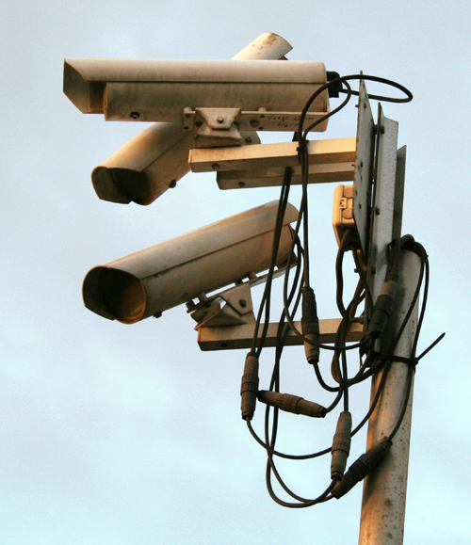
Disabling Cameras
Consider disabling cameras to make it easier to
do a physical attack on a port.
Cameras are often add-ons.
Thus, P_{A} is high.
P_{B/A} > P_{X}: that is whole point of joint
attack. If sufficiently large, then P_{I} > P_{X}.
It could be that cost of the physical attack set up by cyber attack is less than cost of physical attack alone, but in any case |K_{I} – K_{X}| is small.
Almost surely C_{I} > C_{X}.
Even if K_{I} > K_{X}, it seems reasonable to conclude that I is of higher risk than X.
37
Credit for image: commons.wikimedia.org

Slide 38
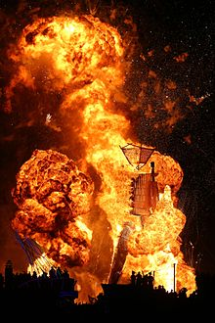
Autonomous Vessels
Could a hacker attack a vessel control system through a HQ computer and disable a sensor designed to identify increasing temperature, pressure, or hazardous gas? (This is A.)
Leading to an explosion. (This is B.)
Not farfetched.
The Stuxnet is a malicious computer worm that targets industrial computer systems.
It put a virus into a controller running centrifuges and damaged them – causing substantial damage to Iran’s nuclear program.
Not the same, but: Naval Dome has demonstrated ability to penetrate a vessel’s machinery control system and stop valves and pumps from working.
Image Credits: militaryaerospace.com,n en.wikipedia.org
38

Slide 39
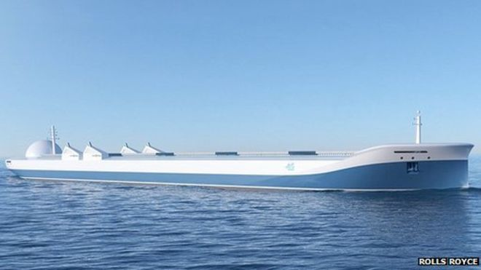
Autonomous Vessels
Compare I to an attack X where a physical attack Y disables a sensor leading to an explosion B.
It is likely that P_{B/A} and P_{B/Y} are similar.
P_{A} may be quite a bit higher than P_{Y}. (Cyber systems more vulnerable than physical ones.)
K_{I} might also be much less than K_{X}.
C_{I} and C_{X} are likely to be similar.
This suggests that the risk of there being an integrated attack I is higher, and maybe considerably higher, than the risk of the attack X.
Credit: Rolls Royce
39

Slide 40
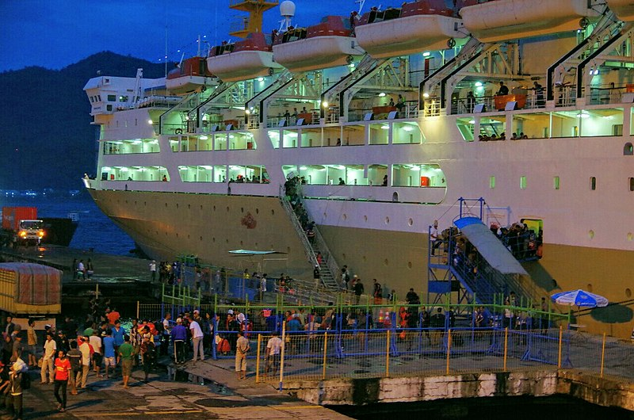
Debarking a Cruise Ship
Compare an integrated cyber and physical attack I that starts with a cyber attack A on an alarm system to a two-part attack that starts with a physical attack Y on the alarm system. Each would end with the same physical attack B on debarking passengers.
Since P_{A} < P_{Y} and P_{B/A} and P_{B/Y} are similar, we have P_{I} < P_{X}. (P_{A} is smaller because Y is easier than A.)
It is hard to tell if K_{I} < K_{X}, but most likely C_{I} and C_{X} are close.
Because security is trained to tell passengers where to go in case of an alarm, it is likely that neither C_{I} nor C_{X} are very large.
Thus, neither I nor X has a very high risk,
and the risk of I is likely smaller than the risk of X.
Credit: Wikimedia commons
40

Slide 41
Debarking a Cruise Ship
On the other hand, an adversary might rethink the scenario if they reach a conclusion like this.
What if they only did the fire alarm attack, didn’t follow with a physical attack, but made a public statement that they have demonstrated their ability to hack into the fire alarm in a port and next time it would be while the vessel was at sea?
That alone could lead to significant economic cost to the cruise ship industry.
If E is the new one-phase attack, P_{E} > P_{I}, probably P_{E} > P_{X}, and (at least if loss of life is small) C_{E} might be close to C_{X} and C_{I} and perhaps even much higher.
Thus, the risk of E might be higher than the risk of either I or X.
41

Slide 42
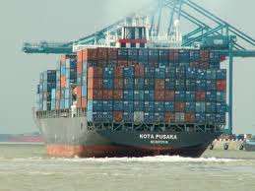
Pirates and Cargo
Even if it is feasible to hack into the cargo system and identify containers of interest and their location, how would this help the pirates since it is only the topmost containers they can access?
Pen Test Partners have shown that hackers can manipulate the cargo handling system to impact placement of cargo (in their case to cause an imbalance).
Compare:
I = hack into cargo system (A) to make it easier to physically steal cargo (B)
X = board a ship and physically steal cargo.
Increasingly, pirates have the sophistication to pull off cyber attacks, so P_{A} might be relatively high. Still, P_{I} might be smaller than P_{X}.
Even if P_{I} is less than P_{X}, most likely K_{I} is not much more than K_{X}, and C_{I} is much higher than C_{X}.
So, again, we conclude that the risk of I is higher than the risk of X.
42
Credit : commons.wikipedia.org

Slide 43
Final Comment
How to best prevent these kinds of integrated attacks or minimize their impacts?
How to compare the value of investing in different countermeasures?
Jumbotron example:
Is there a specific defense against hacking into the Jumbotron at a stadium or train station?
Or is it more cost-effective to develop security initiatives to protect people from a physical attack?
It’s more difficult to compare the benefits and costs of these two approaches quantitatively than qualitatively.
Key first step: make comparisons of relative risk.
Building scenarios for different kinds of integrated attacks can lay the groundwork for development of methods of risk assessment.
43

Slide 44
Thanks to my Co-Authors
And Funders
Alok Baveja
John Betak
Dennis Egan
Peter March
Christie Nelson
Andrew Tucci
Ryan Whytlaw
Thanks to DHS Office of University Programs through grants to the CCICADA Center and the Center for Accelerating Operational Efficiency
44

Slide 45
Integrated Cyber and Physical Attacks on the Maritime Transportation System
For More Information:
Dr. Fred Roberts
froberts@dimacs.rutgers.edu
CCICADA Center
www.ccicada.org
45

