Slide 1
Educating Students To Use Evidence
Nora S. Newcombe
Temple University

Slide 2
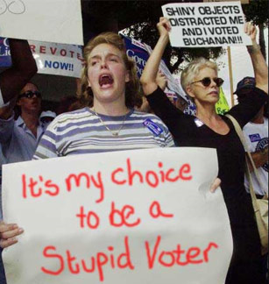
Who We Teach
Relatively few students will go on to become scientists
But all of them will become part of the general public, and some of them will vote
SO—what will they take away from their classes?

Slide 3
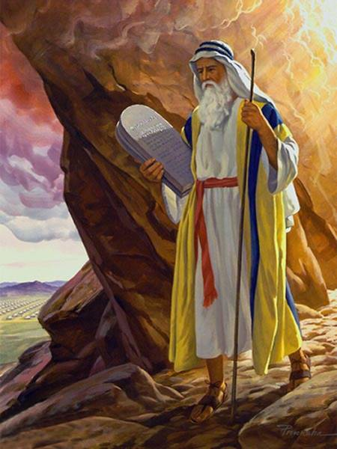
What Do They Want? The Answers
Most college students approach introductory-level courses with the mindset that they will learn the answers from an expert who knows the answers

Slide 4
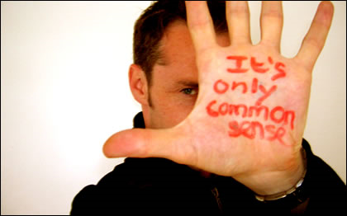
What Do We Have? What We Know Now, How We Know It, and Unanswered Questions
Clearly, this is a tough sell.
And it’s made worse by the fact that as citizens and voters, students will likely default to a different kind of reasoning--

Slide 5
Plan of This Talk
Consider three examples of common-sense policies involving psychological science for which there is contrary evidence
Why do people like common-sense reasoning and resist evidence?
What can we do about these issues in teaching?

Slide 6
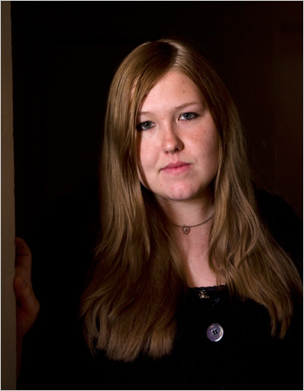
Strip-Search of Girl Tests Limit of School Policy The New York Times, March 23, 2009
Savana Redding still remembers the clothes she had on — black stretch pants with butterfly patches and a pink T-shirt — the day school officials here forced her to strip six years ago. She was 13 and in eighth grade. An assistant principal, enforcing the school’s antidrug policies, suspected her of having brought prescription-strength ibuprofen pills to school.

Slide 7
Zero Tolerance Policies
Widely adopted in schools in the 1990s.
Evaluated in 2008 by an APA Task Force
Are Zero Tolerance Policies Effective in the Schools? An Evidentiary Review and Recommendations. American Psychologist, 63, 852-862.
Data scattered but mostly support the hypothesis that policies do more harm than good.
Many alternatives are available.

Slide 8
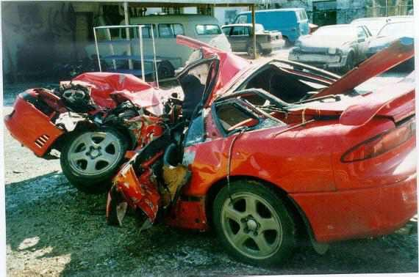
Drowsy Driving Kills Teens
"Most teens and college students have been educated about the dangers of driving while intoxicated, but many are woefully unaware that driving while tired can be just as dangerous," says NSF CEO Richard Gelula, MSW. “According to NSF's 2006 Sleep in America poll, only one in five adolescents (20%) gets an optimal amount of sleep during the week, and more than half (51%) report having driven drowsy in the past year. Other research shows us that young people under the age of 25 are by far the largest at-risk group for these types of crashes.”

Slide 9
Changing Early High School Start Times
A Kentucky school district changed its high school start time from 7:30 to 8:30.
“There was a very statistically significant fall in crash rates in kids in our county where school started an hour later than for the rest of the state. I think that’s really the take-home message here in that later high school start times can reduce crash rates, which obviously has public health implications. “
Danner, F. & Phillips, B. (in press). Adolescent sleep, school start times, and teen auto accidents. Adolescent and Family Health.

Slide 10
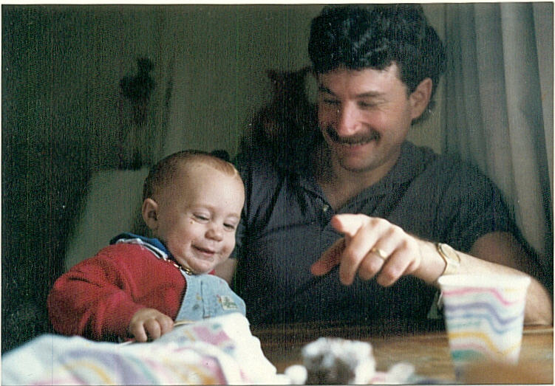
Early Problems Learning to Read
NEW YORK (AP) - Nora Newcombe's son was in first grade, and she was in a state. Andrew was a bright kid, but he just couldn't read. A few months into the school year, he'd scored in the 24th percentile on a standardized reading test. His teacher said he needed to be in a class for children with learning disabilities. Andrew was getting frustrated and upset. "He was like, `I'm stupid. I can't do what the other kids do,' '' Newcombe said.

Slide 11
Deficiencies in a Whole Language Approach
How Psychological Science Informs the Teaching of Reading (2001). Keith Rayner, Barbara R. Foorman, Charles A. Perfetti, David Pesetsky, Mark S. Seidenberg
Since the 1960s, classroom studies of reading methods have consistently shown better results for early phonics instruction compared with instruction emphasizing meaning at the level of words and sentences. This effect is particularly strong for children at risk for reading failure because of lack of home literacy or weak phonological-awareness skills (children who have attention problems, chronic ear infections, articulation problems, or a history of dyslexia in their families). This interaction between children’s characteristics and curricular focus is moderated by instructional factors such as teachers’ knowledge and competency. (p. 37)

Slide 12
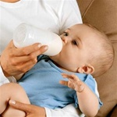
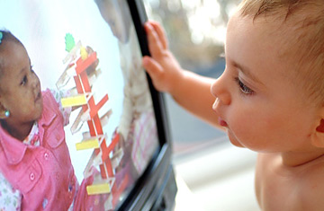
Many Other Issues
50 years ago
Breast versus bottle
Toilet training
Current social programs
Scared Straight
Abstinence-only sex education
Parenting
Nonmaternal care
Better Baby, Baby Einstein
Debated issues
Repressed memory
Children’s eyewitness testimony

Slide 13
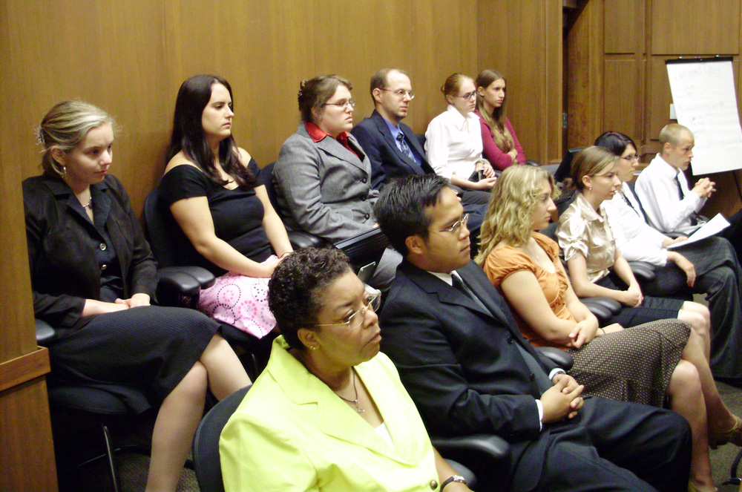
Why Do People Resist Evidence?
Case study of DARE
Principles from cognitive science

Slide 14
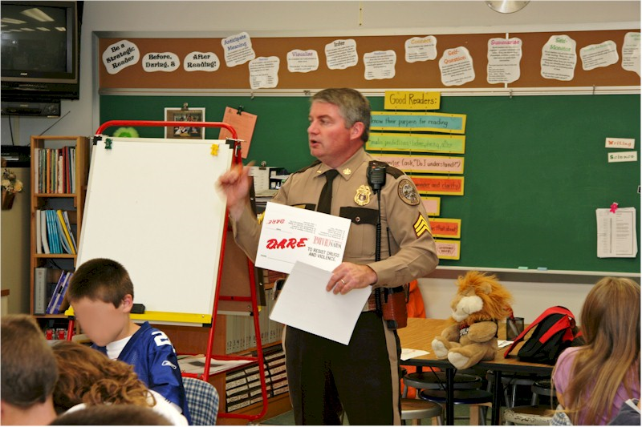
DARE Programs
Drug Abuse Resistance Education began in 1983 and is now implemented in 75% of American schools, according to its website.

Slide 15
But It Does Not Work
Many studies and meta-analyses—for example
Lynam, D. R., Milich, R., Zimmerman, R., Novak, S. P., Logan, T. K., Martin, C., Leukefeld, C., & Clayton, R. (1999). Project DARE: No effects at 10-year follow-up. Journal of Consulting and Clinical Psychology, 67, 590-593.
West, S. L., & O'Neal, K. K. (2004). Project D.A.R.E. Outcome Effectiveness Revisited. American Journal of Public Health, 94, 1027-1029.

Slide 16
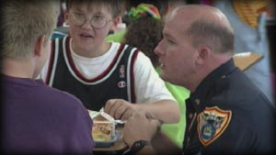
A Widely Disseminated Conclusion
Articles in the NY Times, Newsweek, a PBS show and so on
Surgeon General’s Report, 2001

Slide 17
Other Programs Do Work
Life Skills Training
Botvin, G. J., & Griffin, K. W. (2004). Life Skills Training: Empirical Findings and Future Directions. Journal of Primary Prevention, 25, 211-232.
Strengthening Families; Preparing for the Drug-Free Years
Spoth, R., Reyes, M. L., Redmond, C., & Shin, C. (1999). Assessing a public health approach to delay onset and progression of adolescent substance use: Latent transition and log-linear analyses of longitudinal family preventive intervention outcomes. Journal of Consulting and Clinical Psychology, 67, 619-630.

Slide 18
So Why Don’t School Districts Switch to Effective Programs?
Birkeland, S., Murphy-Graham, E., & Weiss, C. (2005). Good reasons for ignoring good evaluation: The case of the drug abuse resistance education (D.A.R.E.) program. Evaluation and Program Planning, 28, 247-256.
They interviewed community decision makers in 16 school districts in 4 states.

Slide 19
Reasons for Retaining DARE
First, they had never expected D.A.R.E. alone to prevent adolescent drug use; therefore the news that it did not was no surprise.
Second, they believed that evaluators ‘missed the boat, focusing their studies on the wrong outcome measures. The most valuable outcome of D.A.R.E., according to these respondents, is the relationships it fosters among police, families and schools. Yet most evaluation studies neglect that outcome.
Finally, decision makers valued their personal experience with the program as more convincing than scientific evidence. They believed that their program was unique and their D.A.R.E. officer exceptional.

Slide 20
People are Poor Formal Reasoners
Availability heuristic
e.g., my local DARE officer is a great guy
Neglect of base rates
e.g., drug use is low here so DARE works; or--drug use is high here so we need DARE
Focusing effect
e.g., DARE makes kids comfortable with police officers so it is good

Slide 21
Although They May Be Better In Some Circumstances
The ecological rationality approach
Argues that people can’t be too bad at reasoning—they survive!
See for example
Todd, P. M., & Gigerenzer, G. (2007). Environments that make us smart: Ecological rationality. Current Directions in Psychological Science, 16, 167-171.
Yet, the basic approach of this group also acknowledges the ways in which people are not good formal reasoners

Slide 22
What Can Society Do To Support Good Decision-Making?
Use frequencies not percentages in evaluating and explaining risks
Change default options
Opt in versus opt out
Require the use of evidence
While recognizing it is not always available
What Works Clearinghouse sets the bar too high
Provide practice guides

Slide 23
What Can We Do in Teaching?
Do not hesitate to say what we know now
But add how we know
Methods in context
Research design in context
And (judiciously) add the idea that there may be changes in what we know
A dash of history
And also add what we do not know
Presented in a positive way that emphasizes optimism about discovery

Slide 24
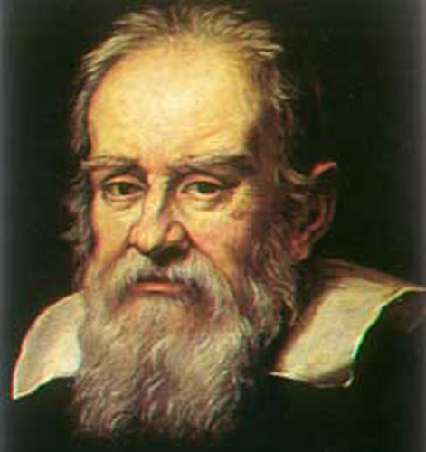
Note That This Idea is Different From Teaching About Evidence
We can additionally teach specifically about program evaluation and statistics
Or specifically about reasoning and its vicissitudes
But my belief is that it’s a scientific cast of mind we most want to create

Slide 25
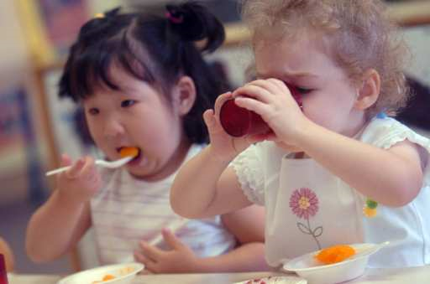
Two Examples
What is the reliability of children’s eyewitness testimony?
How does nonmaternal care affect children’s development?

Slide 26
What We Used To Think
Conflicting claims, all with surface plausibility
Children never lie, and trauma is never forgotten
Children never lie, but trauma is frequently repressed
Children can’t tell truth from untruth and so often lie inadvertently
Children try to tell the truth but their memory systems are immature

Slide 27
What We Know Now
Preschool children are more suggestible than older children or adults, although
Preschoolers sometimes give accurate recollections even in the face of suggestive questioning and even after fairly long periods of time
Adults are also quite suggestible
Even experts cannot tell the difference between true and false reports

Slide 28
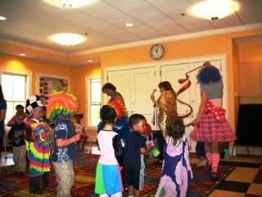
How We Know What We Know
Experimental studies of children in staged situations with planned intervals, question types etc.
Analysis of actual forensic interviews and legal proceedings

Slide 29
What We Still Need to Find Out—What’s on the Horizon
Is there any reliable way to detect true memories?
What is the best way to interview children so as to avoid false positives and false negatives?

Slide 30
What We Used To Think
Bowlby and others suggested that young children need virtually continuous care from an exclusive attachment figure
Original kibbutz ideology suggested that a very short time per day with parents would be sufficient in the context of excellent other care

Slide 31
What We Know Now
Non maternal care does not reduce security of attachment to mother
Higher quality care and more hours in center care are related to higher scores on cognitive and language measures
More childcare hours are related to more problem behavior though still within normal limits

Slide 32
How We Know What We Know
Correlational study of around 1200 American children studied longitudinally (most often cited)
Other correlational studies, not all of which agree with the American one
Review threats to validity of such studies, e.g., self-selection

Slide 33
What We Still Need to Find Out—What’s on the Horizon
What is the mechanism of the associations we have observed?
Are the conclusions culturally- and historically-specific?
What are the limits and determinants of the reaction range in this domain?

Slide 34
What Can We Do in Teaching?
Do not hesitate to say what we know now
But add how we know
Methods in context
Research design in context
And (judiciously) add the idea that there may be changes in what we know
A dash of history
And also add what we do not know
Presented in a positive way that emphasizes optimism about discovery

Slide 35
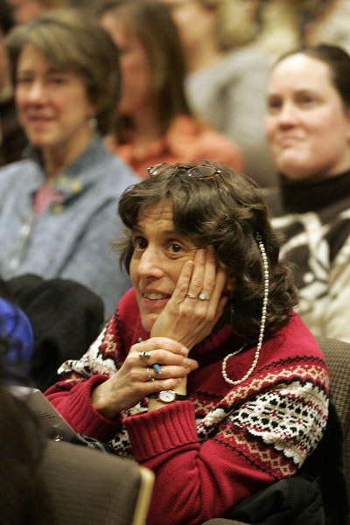
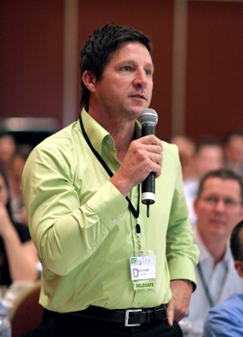
What do you think?

